Slide 1
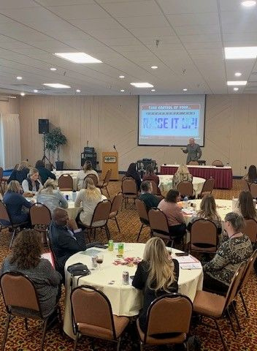
HHRAM 2024
Sponsorship Opportunities
BUSINESS PARTNER PACKAGES AND OPPORTUNITIES

Slide 2
ANNUAL SPONSOR MEMBERSHIP
01
Gain access to conference sponsorship!
Membership Packages
YOU MUST BE A HHRAM MEMBER TO SIGN UP FOR SPONSORSHIP
ANNUAL ELEVATED SPONSOR MEMBERSHIP
02
Get more out of your membership!

Slide 3
MEMBERSHIP PACKAGES AND BENEFITS
You must be a HHRAM member to register for sponsorship
CONSULTANT MEMBERSHIP $250
ELEVATED CONSULTANT MEMBERSHIP
$1,000
PLAN OPTIONS
ABILITY TO SPONSOR CONFERENCES
ONE CUSTOM WEBINAR / SEMINAR FOR HHRAM MEMBERS
LOGO IN HHRAM NEWSLETTERS (2 PER YEAR)
LOGO ON HHRAM WEBSITE

Slide 4
MEMBERSHIP PACKAGES AND BENEFITS (CONTINUED)
You must be a HHRAM member to register for sponsorship
CONSULTANT MEMBERSHIP $250
ELEVATED CONSULTANT MEMBERSHIP
$1000
PLAN OPTIONS
ABILITY TO SUBMIT EDUCATIONAL CONTENT FOR HHRAM NEWSLETTERS
EMAIL LIST ACCESS TO HHRAM MEMBERS
PROMOTION ON HHRAM SOCIAL MEDIA
ADVERTISEMENT IN HHRAM CONFERENCE PROGRAM

Slide 5
01
BRONZE
$2000
Conference Sponsorship Packages
02
SILVER
$2500
03
GOLD
$3000
04
PLATINUM
$3500

Slide 6
CONFERENCE SPONSORSHIP PACKAGES AND BENEFITS
What your chosen sponsorship package gets you
PLAN OPTIONS
BRONZE
$2000
SILVER
$2500
GOLD
$3000
PLATINUM
$3500
CONFERENCE ATTENDEES
2
2
3
4
ONE 6FT TABLE FOR COMPANY INFORMATION AND DISPLAY
RECOGNITION AT THE CONFERENCE
PROMOTION OF BUSINESS IN CONFERENCE GIVEAWAYS

Slide 7
CONFERENCE SPONSORSHIP PACKAGES AND BENEFITS
What your chosen sponsorship package gets you
PLAN OPTIONS
BRONZE
$2000
SILVER
$2500
GOLD
$3000
PLATINUM
$3500
LOGO ON EVENT WEBPAGE
LOGO ON EVENT EMAILS
SPONSOR AN ACTIVITY
ACTIVITY OR BREAK
ACTIVITY, BREAK, DINNER, OR SOCIAL HOUR
ACTIVITY, BREAK, DINNER, OR SOCIAL HOUR
This is on a 1st come 1st served basis, with higher sponsor levels getting priority
PROMOTION ON HHRAM SOCIAL MEDIA

Slide 8
CONFERENCE SPONSORSHIP PACKAGES AND BENEFITS
What your chosen sponsorship package gets you
PLAN OPTIONS
BRONZE
$2000
SILVER
$2500
GOLD
$3000
PLATINUM
$3500
ACCESS TO CONFERENCE ATTENDEE LIST
LOGO IN THE HHRAM CONFERENCE PROGAM
(MAILED TO OVER 500 HHRAM CONTACTS)
Must be registered by Feb 29th 2024
OPPORTUNITY TO INTRODUCE A SPEAKER
(Script provided by HHRAM)
FULL PAGE ADVERTISEMENT IN CONFERENCE PROGRAM
(MAILED TO OVER 500 HHRAM CONTACTS)

Slide 9
HOW OUR SPONSORS BENEFIT
Focused Engagement
Hightened Visibility
No matter what level sponsor you are, we ensure that you get plenty of facetime with HHRAM attendees. All conference breaks are directed toward maximizing your exposure and fostering meaningful connections.
Your brand will receive heightened visibility through HHRAM social media and our mailing list of over 500 contacts.
Quality Networking
Our conferences create a prime environment for targeted networking, enabling you to connect with key decision-makers.

